Slide 1
Case Study:
Towards a Standard Feature Set for Network Intrusion Detection System Datasets
Mohanad Sarhan , Siamak Layeghy , Marius Portmann
TEAM 5 - CMPE 257 sec-02
Presented by :
Aryan Dandwekar
Joao Lucas Veras
Eshan Chawla
Uday Arora
Notes:
We will now present our case study on the paper titled: “Towards a Standard Feature Set for Network Intrusion Detection System Datasets” published in the Mobile Networks and Applications journal.

Slide 2
Problem Statement

Slide 3
Problem the Paper Addresses
NIDS datasets use inconsistent feature sets → poor generalization.
Models memorize dataset patterns instead of learning attack behavior.
Results in unfair benchmarking and low reproducibility.
Paper proposes a 43-feature standardized NetFlow v9 set.
Goal: enable reliable, deployable ML-based IDS evaluation.
Notes:
First I will explain the problem this paper addresses:
One of the main issues in NIDS research is that different datasets use completely different feature sets.
Because of this, models often end up memorizing dataset-specific patterns instead of learning real attack behavior.
That leads to poor generalization that means a model trained on one dataset usually fails on another.
It also makes benchmarking unfair and results hard to reproduce.
To solve this, the paper proposes a standardized 43-feature set based on NetFlow v9, designed to make machine learning–based intrusion detection more consistent and comparable across datasets.

Slide 4
How It Connects to Our Project
Our FLNet dataset has 82 flow-level features, similar to NetFlow v9.
Paper standardizes features to improve NIDS dataset consistency.
Inspired our feature-cleaning and selection process.
Helped us handle redundancy and leakage effectively.
Connects dataset design to ML model reliability.
Notes:
Now I will explain how this paper connects to our project.
Our FLNet dataset also focuses on flow-level features, it originally had 82 features which we had reduced to 30, analysing this paper will help us find flaws and improvements for our feature selection process this will help us remove redundancy, avoiding label leakage, etc .
Analysing this paper also helped us understand how feature consistency directly affects the reliability of ML models for intrusion detection.
So, their approach basically guided our dataset preparation and feature-selection process, making our models more robust and comparable.

Slide 5
Proposed Solution
Notes:
Thank you. The core solution centers on replacing the proprietary, custom feature sets with an established industry-standard protocol: NetFlow.

Slide 6
Proposed Solution
Core Idea
  Propose a standard feature set for NIDS datasets based on the NetFlow network meta-data collection protocol and systems
Why NetFlow
  NetFlow is a de-facto industry standard for traffic collection and analysis
Key Advantages
  Features are highly practical and scalable for deployment
  Features are flow-based and extracted from packet headers
Variants of Features
  Basic 12 features
  Proposed Standard 43 features
Notes:
So, how did the paper solve this problem of inconsistent datasets?
The core idea was to propose a standard feature set for all NIDS datasets, and to base it on the NetFlow protocol.
Why NetFlow? For a few very practical reasons:
First, it's the de-facto industry standard for traffic collection and analysis.
This makes it highly practical and scalable for real-world deployment, since many routers and switches already support it.
And critically, the features are flow-based and extracted from packet headers. This means they don't rely on the payload, so the NIDS can still work even when traffic is encrypted—which is most traffic today.
The paper compared two versions: a basic 12-feature set and their proposed standard of 43 features. As we'll see, that 43-feature set is the key to their results.

Slide 7
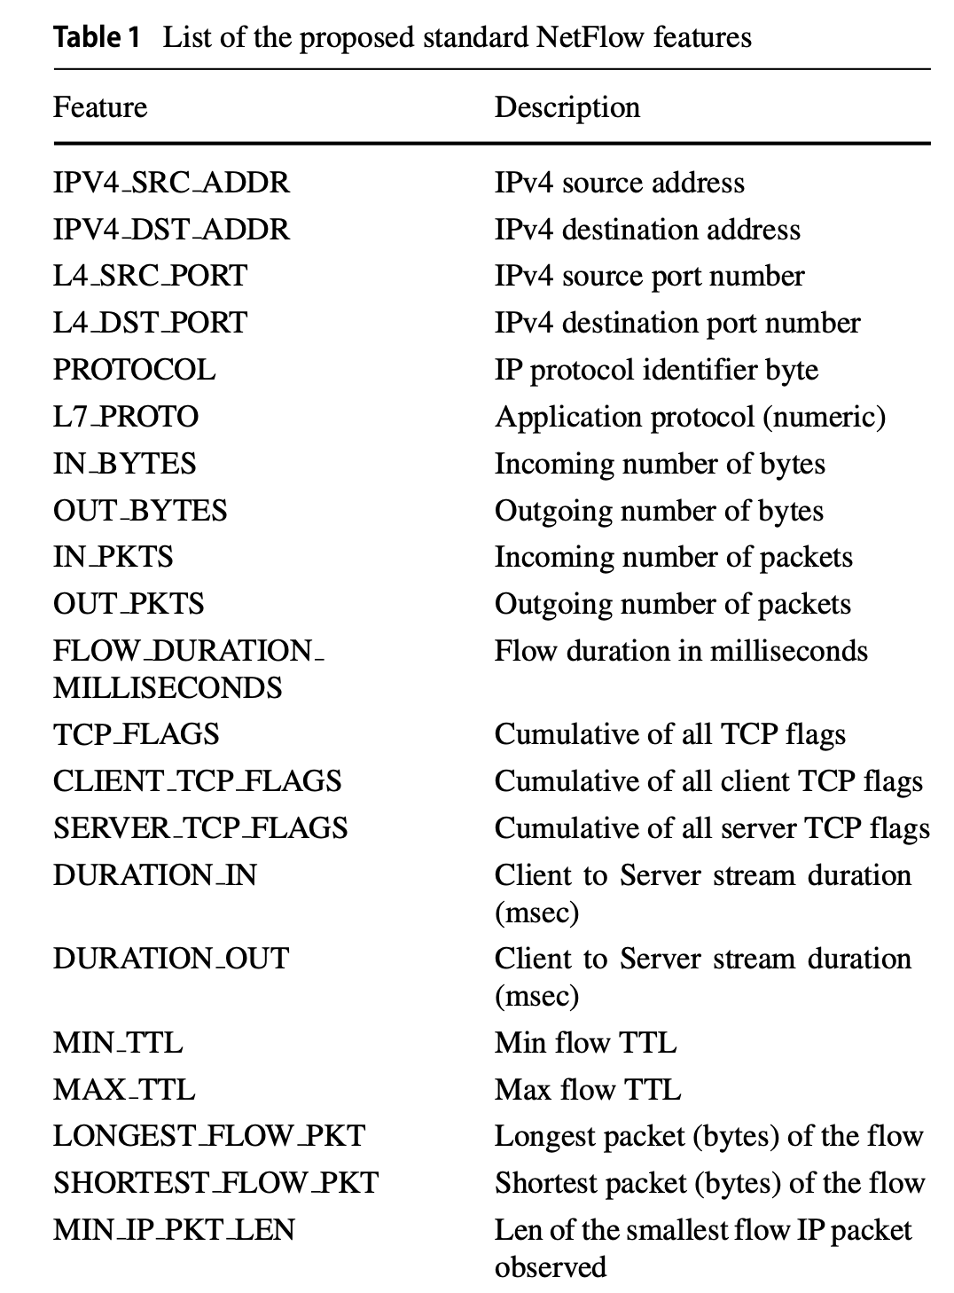
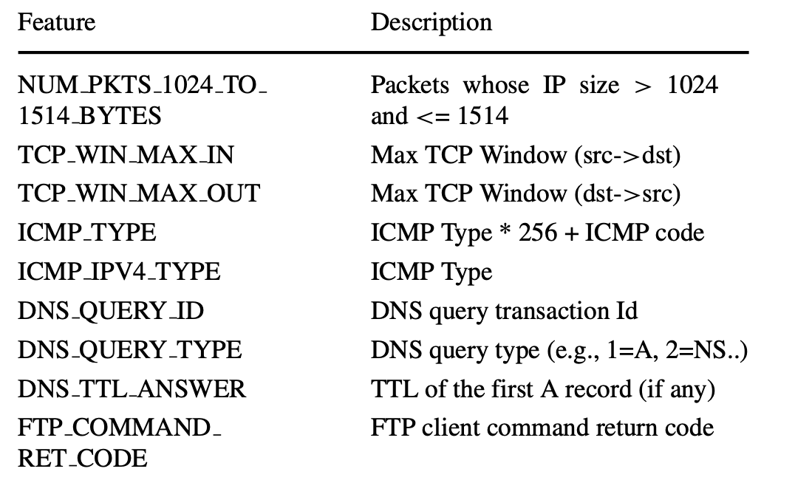
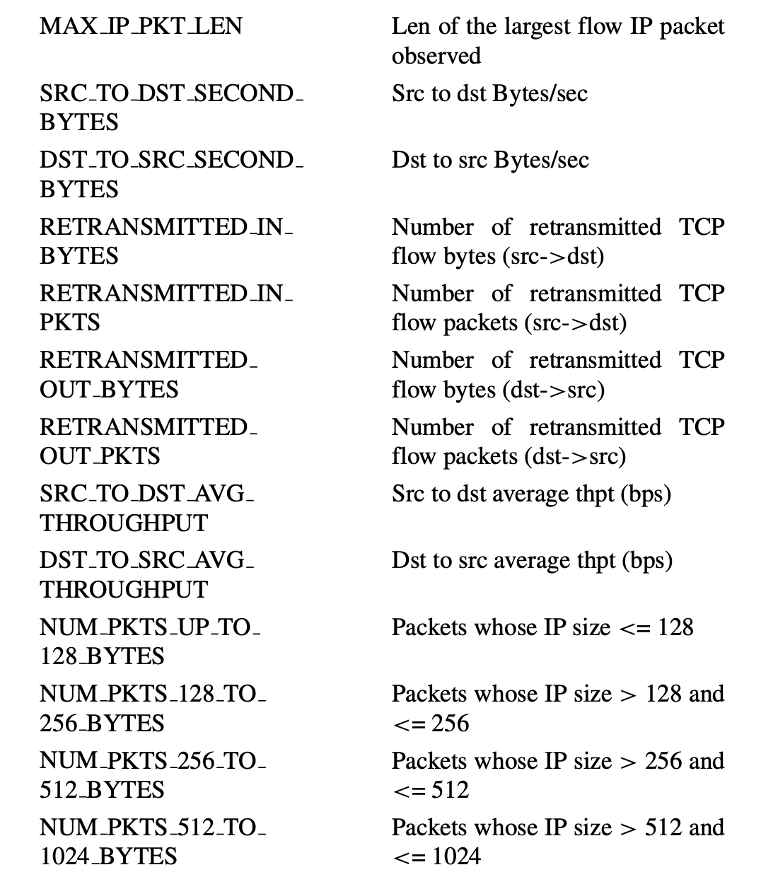
NIDS Features
Notes:
So, what are these 43 features?
This slide shows the complete list, and while we won't go through every single one, I want to highlight the types of information they're capturing. You can see they've broken them down into logical groups.
First, you have the basic identifiers—the "who, what, and where" like IP addresses and port numbers.
Next, you have volume and duration, which includes things like IN_BYTES, OUT_PKTS, and FLOW_DURATION. This tells you how much data was sent and for how long.
Then, you get crucial behavioral features. This includes TCP_FLAGS and RETRANSMITTED packets, which are excellent for spotting things like port scans or unusual connection behavior.
Finally, they include application-layer details for specific protocols like DNS_QUERY_TYPE and FTP_COMMAND.
This combination gives a very comprehensive, multi-layered view of the traffic, using only standardized, header-based information."

Slide 8
New Dataset Generation
Utilized the publicly available packet capture files from four widely-used NIDS datasets
  UNSW-NB15, BoT-IoT, TON-IoT, CSE-CIC-IDS2018
Extracted using the nProbe tool by Ntop
  Extracted the 43 NetFlow version 9 features
Convert the original datasets into new variants utilizing the 43 proposed features
  NF-v2 datasets
All the new datasets share the same standard features
Allows for all datasets to be merged into a comprehensive dataset
  Displays the power of having a standard feature set
Notes:
The researchers didn't just propose this set—they proved it would work.
First, they took the publicly available raw packet capture (pcap) files from those four famous datasets we mentioned: UNSW-NB15, BoT-IoT, TON-IoT, and CSE-CIC-IDS2018.
Next, using a standard tool called 'nProbe' , they re-processed all of this raw traffic, but this time they extracted only their proposed 43 NetFlow v9 features.
This process created new, standardized versions of each dataset, which they call the 'NF-v2' datasets.
And here is the most powerful part: because all these new datasets now share the exact same standard features, they can be combined. The authors were able to merge all four into a single, comprehensive dataset. This right here demonstrates the true power of having a standard—it allows us to create richer, more diverse data for training our models."

Slide 9
Evaluation of Applied Techniques

Slide 10
Key Results and observations
Tested binary (attack/benign) & multi-class (attack types).
Used Extra Trees Classifier + 5-fold cross-validation.
Compared 3 setups: Original, Basic (12), and Extended (43) features.
Metrics: Accuracy, AUC, F1, DR, FAR, Prediction Time.
Found highest performance with 43 NetFlow features.
Notes:
The authors evaluated their proposed feature set through both binary and multi-class classification tasks using the Extra Trees model.
They applied five-fold cross-validation and measured accuracy, AUC, F1, detection rate, falsealarm rate, and latency.
Three configurations were compared — the original dataset features, a basic 12-feature NetFlow version, and the extended 43-feature set.
Across all datasets, the extended 43-feature NetFlow configuration produced the best accuracy

Slide 11
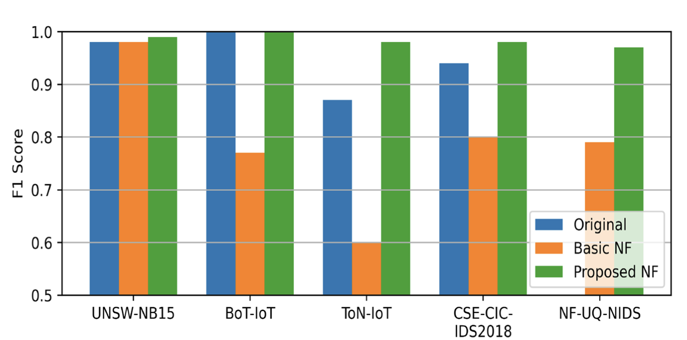
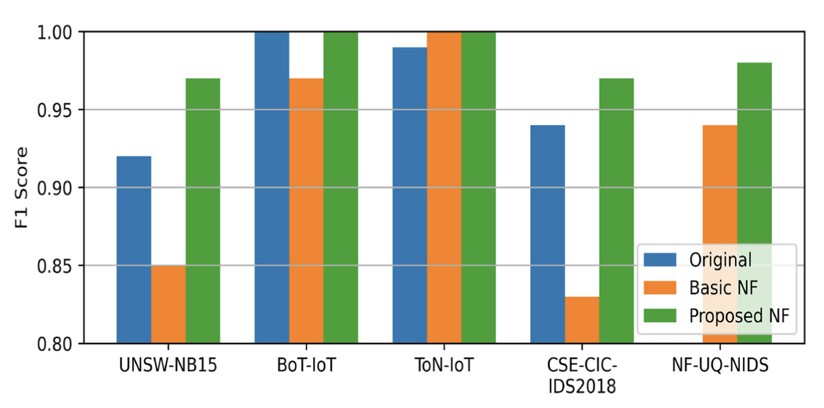
Dataset Evaluation
Multi Class Classifier
Binary Classifier
Notes:
43 features proposed (can refer photos on slide 7)
12 base feature set: IPV4_SRC_ADDR, IPV4_DST_ADDR, L4_SRC_PORT, L4_DST_PORT, PROTOCOL, IN_BYTES, OUT_BYTES, IN_PKTS, OUT_PKTS, FLOW_DURATION_MILLISECONDS, TCP_FLAGS, L7_PROTO
We had 82 features for FLNET: 'flow_duration', 'flow_byts_s', 'flow_pkts_s', 'bwd_pkts_s',
'tot_fwd_pkts', 'fwd_pkt_len_max', 'fwd_pkt_len_min', 'fwd_pkt_len_std',
'bwd_pkt_len_min', 'fwd_seg_size_min', 'flow_iat_mean', 'flow_iat_max',
'flow_iat_min', 'flow_iat_std', 'fwd_iat_min', 'bwd_iat_tot',
'bwd_iat_max', 'bwd_iat_mean', 'fin_flag_cnt', 'down_up_ratio',
'init_bwd_win_byts', 'active_max', 'active_min', 'active_mean',
'idle_min', 'idle_mean', 'fwd_byts_b_avg', 'bwd_byts_b_avg',
'fwd_blk_rate_avg', 'bwd_blk_rate_avg'

Slide 12
Key Results and observations
Average F1 improved by 5–10%.
Multi-class F1: 0.79 → 0.97 (merged dataset).
Weak detection on Infiltration, MITM, SQL Injection.
No cross-dataset validation → limited proof of generalization.
Lower prediction latency (up to 50% faster).
Notes:
The results showed a clear accuracy improvement — the average F1 score improved by up to
10%, and the merged dataset’s F1 jumped from 0.79 to 0.97.
However, some attacks like Infiltration and MITM remained hard to detect, suggesting that
NetFlow data alone may not fully capture those behaviors.
Latency per flow decreased significantly, making their setup computationally eﬃcient.
Another limitation is that they tested within each dataset but didn’t train on one and test on
another, so their generalization capability remains uncertain.

Slide 13
Learnings
Adopt their binary + multi-class structure for fairness.
Add cross-time validation to simulate unseen traﬃc.
Introduce feature-importance (SHAP/PCA) analysis.
Compare standardized vs attack-specific feature sets.
Track latency & accuracy for real-time feasibility.
Notes:
Their evaluation gave us a good foundation, but we’re expanding it in several ways.
We’ll use the same binary and multi-class setup for fair benchmarking, but also add cross-time validation to simulate unseen traﬃc conditions rather than a regular 30-70 split.
[5 fold cross validation]
We have implemented PCA earlier to reduce features but we can use SHAP / PCA with the prediction value to analyze feature importance for our implementation which they didn’t include.
We’ll also compare standardized versus attack-specific engineered features within FLNet.
Finally, we’ll measure both accuracy and latency to assess whether our models could work in real-time network intrusion scenarios

Slide 14
Group Suggestions or Adaptations
Notes:
Now I will talk about how analysing this paper is shaping our future work for this project

Slide 15
Improving Feature Design and Dataset Use
Adopt 43 NetFlow features → add retransmission, TCP flags, packet-size bins, DNS/ICMP.
Use merged NF-UQ-NIDS dataset for broader training and testing.
Revisit TTL: test drop vs transform (range/variance) to avoid leakage.
Focus on flow-visible attacks (like DoS, DDoS).
Look into hybrid approach for attacks needing payload data (like SQLi, XSS, infiltration).
Notes:
We’ll now align our feature set with the 43 NetFlow features proposed in this paper and train on the dataset published by them.
These add retransmission counts, TCP-flag summaries, packet-size bins, and ICMP/DNS info which will give a fuller picture of traffic behavior that was not captured in our previous feature selection process.
For the TTL based features, instead of removing it completely like done in the paper, we’ll test a transformed version representing TTL range or variance to keep clues for detecting spoofing attacks..
Finally, we’ll shift focus on attacks that are more detectable with just net-flow data, such as DoS and DDoS, and look into alternative hybrid approaches for attacks like SQL injection and cross site scripting whose detection heavily relies on payload data something that’s not captured in the netflow format.

Slide 16
Strengthening the Modeling Approach
Go beyond Extra Trees → test RF, XGBoost, SVM, Logistic Regression.
Apply 5-fold cross-validation to check overfitting.
Add cross-time testing for temporal stability.
Perform adversarial tests (small feature changes, flow splitting).
Look into hybrid detection (flow + payload/host-level).
Notes:
The paper relied only on Extra Trees, but we’ll test four models — Random Forest, XGBoost, SVM, and Logistic Regression — to see how different algorithms learn from the same flow data.
We’ll now add cross-time testing to see if accuracy holds when traffic patterns change and use 5-fold cross-validation applied in this paper to catch overfitting as this was something that was one of our concerns after seeing the near perfect results which we showed during the mid term presentation.
We’ll also run adversarial tests by making small flow changes to check robustness of models in such scenarios and try to learn what we can do to protect against that.
We also want to find more about how hybrid solutions can be implemented that may use models trained on netflow data with modules that also analyse the payload as we have now realised that just relying on netflow data is not a one stop solution to detecting an attack.

Slide 17
Evaluation and Next Steps
Use consistent metrics: Accuracy, F1, AUC, DR, FAR, latency.
Test binary and multi-class attack specific models.
Research standard NIDS evaluation methods for fair comparison.
Explore privacy-safe features (TLS handshake, payload entropy).
Compare accuracy vs latency for deployment readiness.
Notes:
Our evaluation will use the same metrics applied in the paper so we can compare results to it as well.
(Accuracy, F1, AUC, Detection Rate, False Alarm Rate, and latency)
We also plan to look into any standardized evaluation methods if they exist for NIDS research to make results easier to compare.
Apart from the attack specific classifiers, we also saw in the paper they trained a binary classifier to detect general malicious flow, we want to test if this is something that can actually work in realistic attack scenarios.
Lastly, we’ll explore privacy-safe features such as TLS handshake metadata or payload entropy and also study how accuracy balances with latency.

Slide 18
References
Case Study Paper:
Sarhan, M., Layeghy, S. & Portmann, M. Towards a Standard Feature Set for Network Intrusion Detection System Datasets. Mobile Netw Appl 27, 357–370 (2022). https://doi.org/10.1007/s11036-021-01843-0
Dataset: https://fkie-cad.github.io/COMIDDS/content/datasets/flnet2023/
Colab Notebook: https://colab.research.google.com/drive/147fRUwBCbiSsKXKJA5A8Bp4HE6uIkvEA?usp=sharing

Slide 19
Any Questions ?

